Slide 1
Python 3.4.0
Caleb Meyer
Software Engineer
Pop Health Analytics Applications

Slide 2
Short List of Features
PEP 428, a "pathlib" module providing object-oriented filesystem paths
PEP 435, a standardized "enum" module
PEP 436, a build enhancement that will help generate introspection information for builtins
PEP 442, improved semantics for object finalization
PEP 443, adding single-dispatch generic functions to the standard library
PEP 445, a new C API for implementing custom memory allocators
PEP 446, changing file descriptors to not be inherited by default in subprocesses
PEP 450, a new "statistics" module
PEP 451, standardizing module metadata for Python's module import system
PEP 453, a bundled installer for the pip package manager
PEP 454, a new "tracemalloc" module for tracing Python memory allocations
PEP 456, a new hash algorithm for Python strings and binary data
PEP 3154, a new and improved protocol for pickled objects
PEP 3156, a new "asyncio" module, a new framework for asynchronous I/O

Slide 3
Too much? I agree
PEP 428, a "pathlib" module providing object-oriented filesystem paths
PEP 435, a standardized "enum" module
PEP 436, a build enhancement that will help generate introspection information for builtins
PEP 442, improved semantics for object finalization
PEP 443, adding single-dispatch generic functions to the standard library
PEP 445, a new C API for implementing custom memory allocators
PEP 446, changing file descriptors to not be inherited by default in subprocesses
PEP 450, a new "statistics" module
PEP 451, standardizing module metadata for Python's module import system
PEP 453, a bundled installer for the pip package manager
PEP 454, a new "tracemalloc" module for tracing Python memory allocations
PEP 456, a new hash algorithm for Python strings and binary data
PEP 3154, a new and improved protocol for pickled objects
PEP 3156, a new "asyncio" module, a new framework for asynchronous I/O

Slide 4
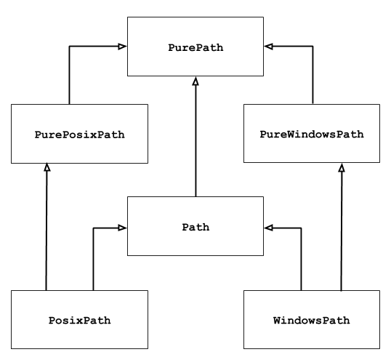
pathlib
Historically done using strings or the path.py module.
Now standardized!

Slide 5
pathlib
Historically done using strings or the path.py module.
Now standardized!
Use this one!

Slide 6
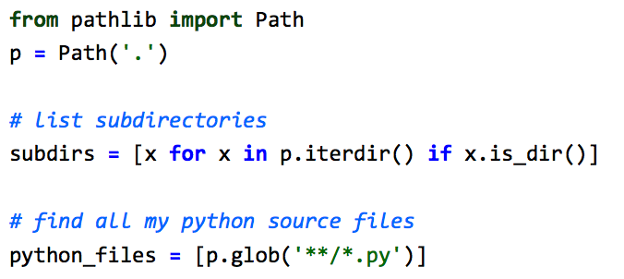
pathlib
What can I do now that I couldn't before?

Slide 7
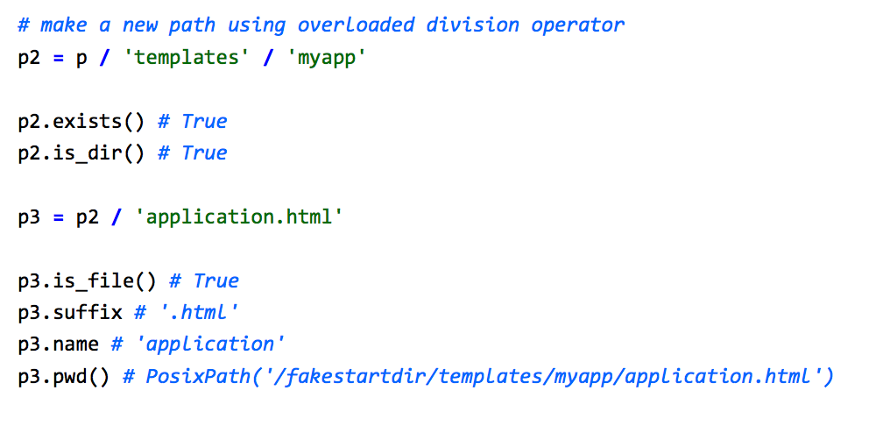
pathlib

Slide 8
pathlib
Why?
Handles windows case_insensitivity.PY
More convenient than regexing out different parts of the path
Path('.'), p.rmdir(), etc. mean the same thing on windows and unix based systems.

Slide 9
enum
There are two new types of enumerations, Enum and IntEnum.
Enum is used wherever a related set of constants are needed.
Notes:
Those watching closely may have noticed that enum was attempted back in 05, as PEP 354. However, it wasn’t until PyCon 2013 that it was seriously discussed.

Slide 10
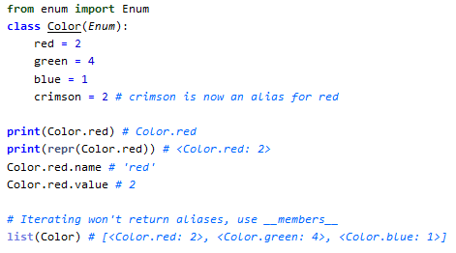
enum

Slide 11

enum
A few tips
Enums can only be extended if they don’t define any members
_singleunder_() methods are reserved by Enum (you can’t create them)
You can use the @unique decorator to enforce no aliases.
You can create an enum functionally:
Notes:
You can also pass a sequence of 2 tuples, or dictionary

Slide 12
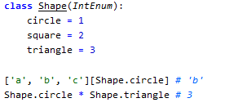
IntEnum
This is a variant of enum that extends Int. It has all the usual properties of integers, so you can do things like:

Slide 13

kitten break
If you haven’t watched Cal Henderson talk about django, you should!

Slide 14
statistics
Hooray, now we don’t have to bring in scipy just to do basic stats
This package includes mean, median (low, high, average, grouped), mode, and sample and population standard deviation and variance

Slide 15
pip
Pip will do its best to install itself alongside your python 3.4
This means that there will be less squabbling over Setuptools vs Distribute vs distutils vs pip vs easy_install
This means that third party packages won’t have several names depending on your package manager (was it apt-get install django or python-django?)

Slide 16
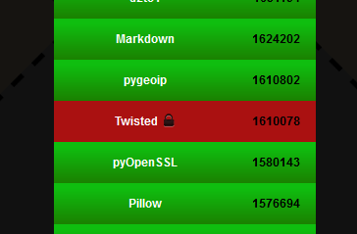
asyncio
From the docs:
This module provides infrastructure for writing single-threaded concurrent code using coroutines, multiplexing I/O access over sockets and other resources, running network clients and servers, and other related primitives
What does that mean?
Twisted can finally move off the python 3 wall of shame:
http://python3wos.appspot.com/

Slide 17
Questions?
That I can answer…
How can I get python 3.4?
Check out Steven’s awesome blog post about pythonz: https://connect.ucern.com/blogs/is-this-thing-on
How can I get this awesome powerpoint theme?
I’ll post this presentation on the ucern group, look for it soon!

